Slide 1
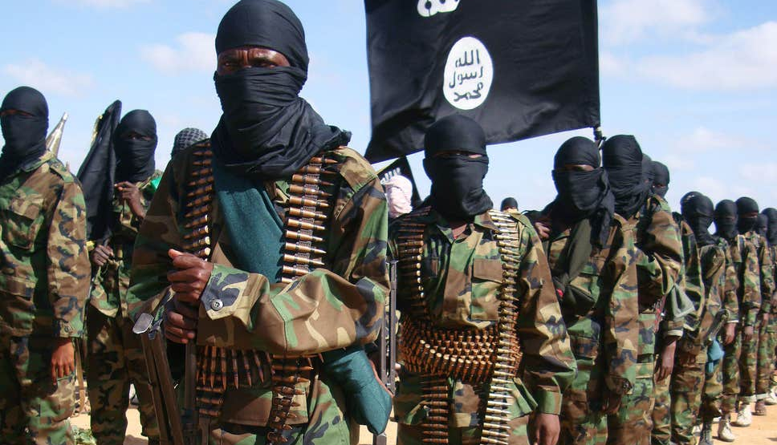
Social Network analysis of ISIS fanboys in Twitter
Will Hibbard
Nathaniel Simon
Fayika Farhat nova

Slide 2
Background
ISIS (Islamic State in Iraq and Syria)
Established in 2006, an ally of Al-Qaeda
A Sunni jihadist group with a particularly violent ideology
Wants to implement Sharia law in order to create a society resembling Iraq and Syria in the 18th century
90 attacks in 21 countries have killed nearly 1,400 people [Source: https://www.cnn.com/2014/08/08/world/isis-fast-facts/index.html]
What is a fanboy
Generally an active fan of something
Here it means someone that has interacted with ISIS twitter is such a way that they are seen as “supporting” or “being active” on the issues related to ISIS
Around 17000+ tweets from 100+ pro ISIS fanboys
Tweets taken starting from: (Jan 2015- May 2016)
This data set can help us see:
Social Network Cluster Analysis
Keyword Analysis
Timeline View

Slide 3
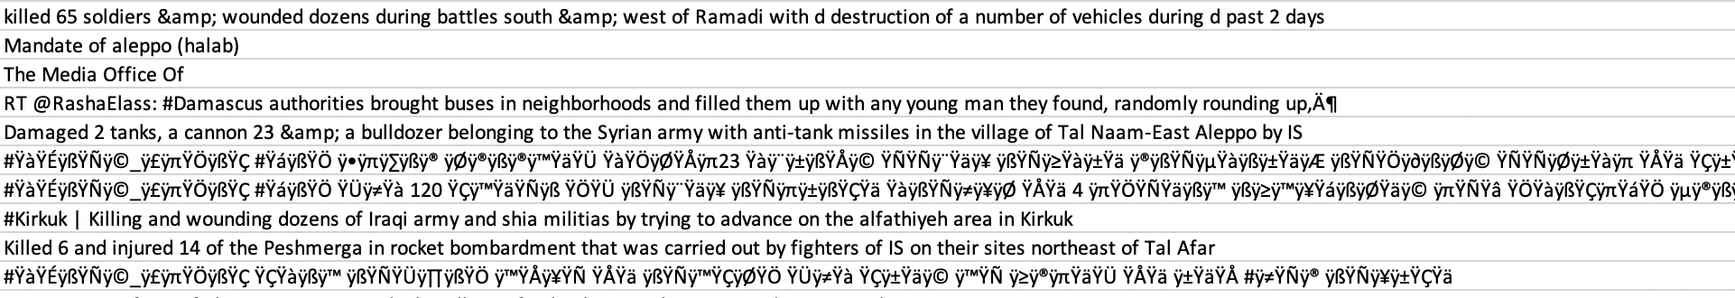
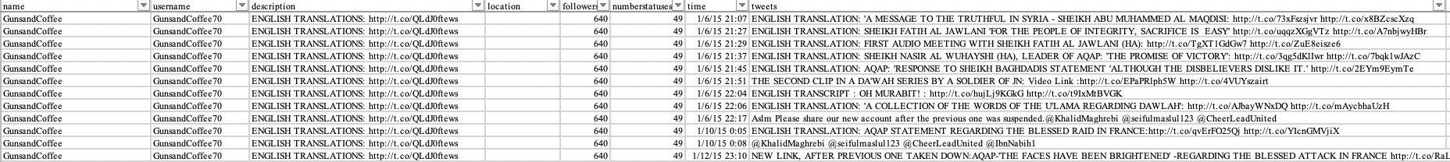
Data set
Cleaning
https://www.kaggle.com/fifthtribe/how-isis-uses-twitter#tweets.csv
Name
Username
Description
Location
Followers
Number Statuses
Time
Tweet
Some of the tweets were encrypted
In Arabic = limitation for us
Removed those and cleaned it out

Slide 4
Visual Graphs
Highest Followers
Total Tweets Shared

Slide 5
Research Questions
RQ1: How does the social network cluster look like based on this dataset?
RQ1a. Who are the central nodes?
RQ1b. Which are the nodes working as bridges?
RQ2. What are the most prominent timelines for the ISIS related tweets?
RQ2a. What are the events related to the prominent timelines?
RQ2b. In which timelines, fanboys shared the most tweets?
RQ3. What hashtags were prominent within the ISIS fanboys?
RQ3a. Did the central nodes use the hashtags?
RQ3b. In which timelines the hashtags were mostly used?

Slide 6
Challenges:
The data frames are corrupted
Dataset includes non-ISIS data
We can’t distinguish between old vs. new nodes
Not aware of the keyword used to scrap data from Twitter
Not sure how they defined ISIS fanboys!

